Slide 1
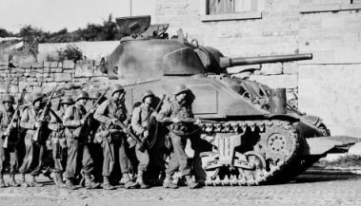
World War Two
Top 20 World War Two Facts For KS2 Kids
The war lasted six years and one day.
WWII began on September 1st 1939.
WWII ended on September 2nd 1945.
The war began when Germany invaded Poland.
Great Britain declared war against Germany on September 3rd 1939.
Germany was led by Adolf Hitler - the leader of the Nazi party.
.
The first German serviceman killed in the war was killed by the Japanese. ...
The first American serviceman killed was killed by the Russians. ...
Over 100,000 Allied bomber crewmen were killed over Europe. ...
More US servicemen died in the Air Corps that the Marine Corps.
World War II involved many countries around the globe fighting against each other, including the UK. It lasted six years, from 1939-1945. The War became a global conflict after the German military, led by Adolf Hitler, invaded Poland in 1939 because he wanted to take some of their land for Germany.

Slide 2
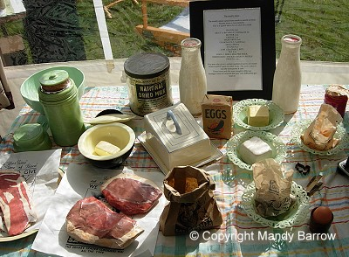
World War Two FOODS
Bacon & Ham 4 oz.
Other meat value of 1 shilling and 2 pence (equivalent to 2 chops)
Butter 2 oz.
Cheese 2 oz.
Margarine 4 oz.
Cooking fat 4 oz.
Milk 3 pints.
Sugar 8 oz.

Slide 3
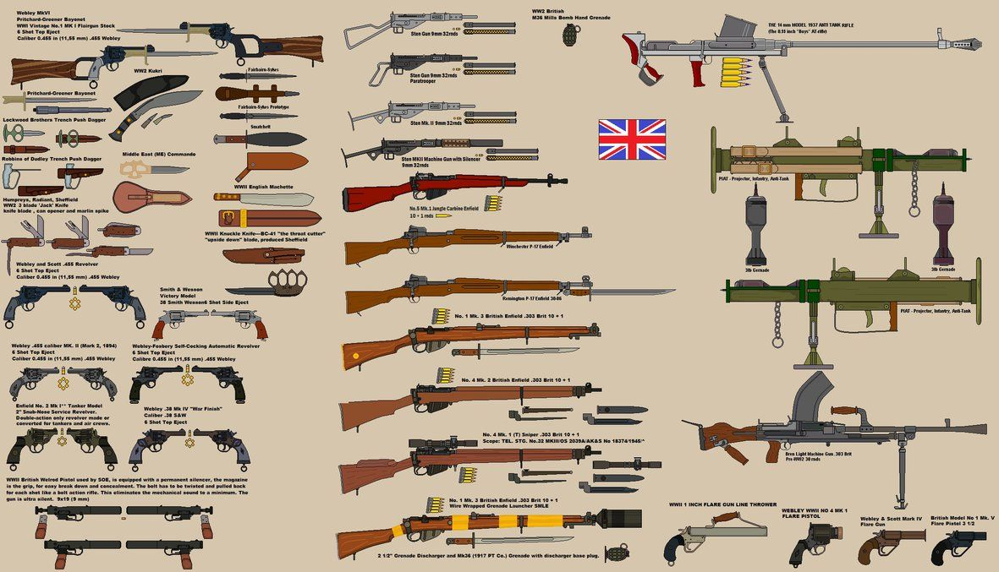
WW2 BRITSH GUNS
40 mm weapon used at start of the war
Ordnance QF 6-pounder - 57 mm weapon that replaced 2-pounder in artillery units
Ordnance QF 17-pounder - 76 mm weapon introduced later in war for artillery units
Ordnance QF 25-pounder Gun-howitzer
BL 5.5-inch Medium Gun
BL 4.5-inch Medium Field Gun
BL 7.2-inch Howitzer Mk.I
BL 8-inch Howitzer - siege gun
BL 60-pounder gun - 5 inch gun from First World War era, replaced by 4.5 inch gun during war
75 mm Pack Howitzer M1 and M8 - US supplied portable howitzer for use in mountainous areas
QF 3.7-inch mountain howitzer
Smith Gun - smoothbore weapon for Home Guard use only
BL 9.2-inch howitzer - WWI era
75 mm gun M1917 - US supplied, training and home defence after fall of France
QF 18-pounder gun - WWI era, replaced by 25 pdr
Coast defence guns
QF 6-pounder 10 cwt
QF 12-pounder
QF 4.7-inch Mk I–IV

Slide 4
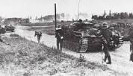
Who won the ww2 and why?
When did ww2 start and end?
World War II (WWII or WW2), also known as the Second World War, was a global war that ... The Nationalists won the civil war in April 1939; Franco, now dictator, remained officially neutral during World War II but generally favoured the Axis.‎Mediterranean and Middle ... · ‎List of theaters and campaigns ... · ‎Allied · ‎Timeline
World War II began in Europe on September 1, 1939, when Germany invaded Poland. Great Britain and France responded by declaring war on Germany on September 3. The war between the U.S.S.R. and Germany began on June 22, 1941, with the German invasion of the Soviet Union.

Slide 5
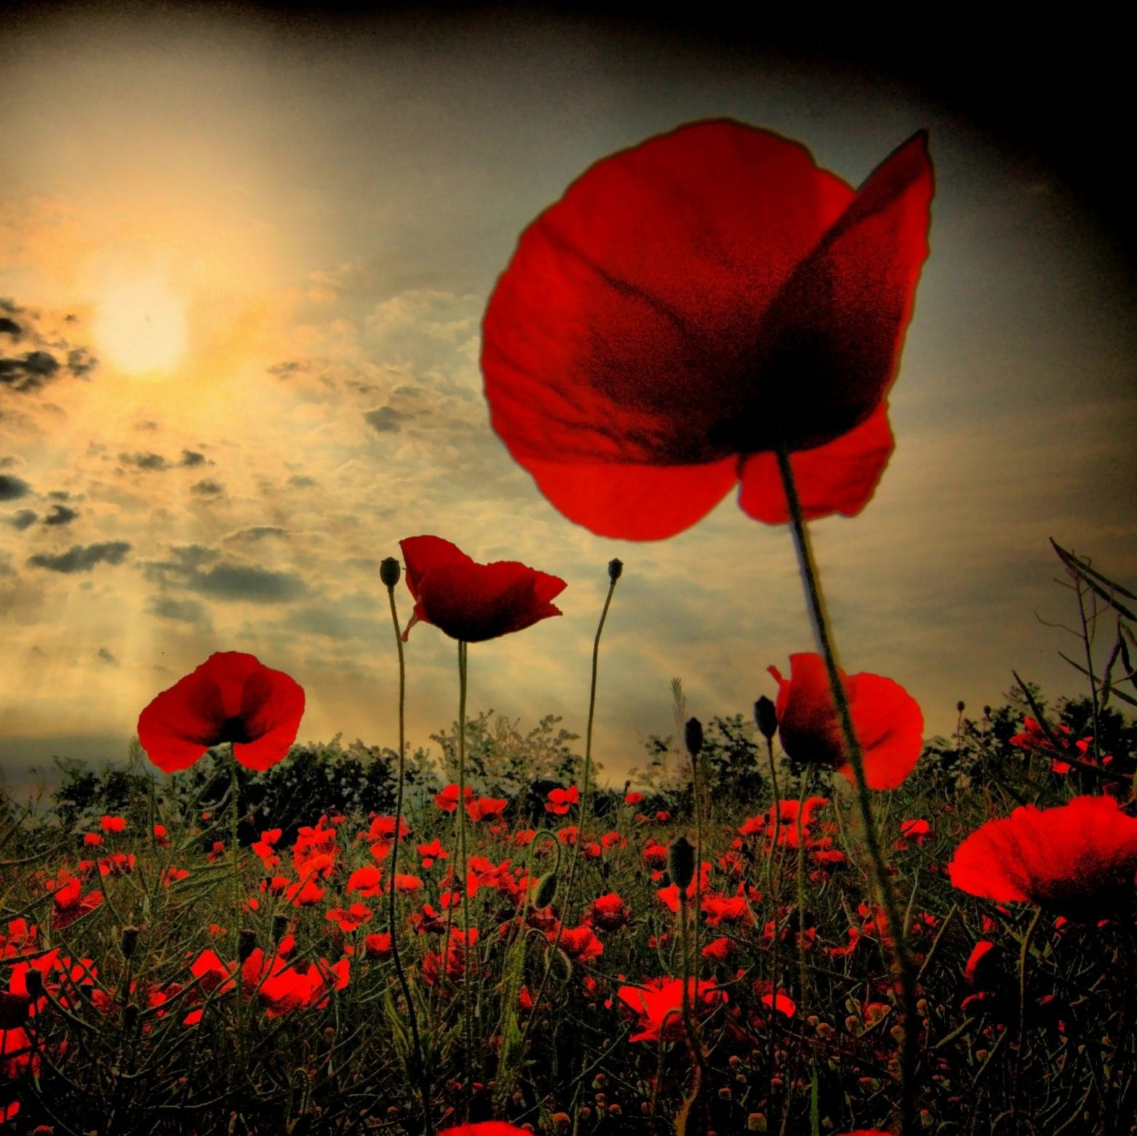

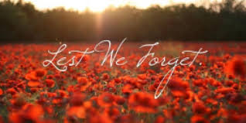
We Will Remember
We will remember the people that die the men and women who gave up their lives, no we won’t forget the price that was paid by the soldiers that fought in the war.
For king and country they battled on they are our heroes each and everyone no we won’t forget the price that was paid by the soldiers that fought in the war.
So that the future generations would know a land that is free they gave there live for this nation people like you and me so that the future generation would know a land that is free so that people of this nation people like you and me could be free.

